Slide 1
RDA Cataloging Cooperative
Question 1 - How do I train my catalogers in RDA?
Adam L. Schiff
Principal Cataloger
University of Washington Libraries
aschiff@uw.edu

Slide 2
AACR2 vs. RDA
Much of AACR2 has been carried over to RDA
Significant differences, but a lot is the same
Terminology changes can confuse people
Understanding FRBR group 1 and 2 entities will make applying RDA easier
Training - use existing resources from LC, PCC, BL, ALCTS, etc. and consider developing additional exercises to do individually but to go over as a group
Have tolerance for ambiguity and uncertainty during this period while things are shaking out

Slide 3
Significant Differences - Descriptive
GMD replaced by content type, media type, carrier type (336, 337, 338); include these elements even when no GMD would have been used
245 10 Bangladesh Constitution : $b
trends and issues / $c Mustafa
Kamal.
260 Dhaka, Bangladesh : $b University
of Dhaka, $c 1994.
300 xvi, 177 p. ; $c 22 cm.
245 10 Bangladesh Constitution : $b
trends and issues / $c Justice
Mustafa Kamal.
264 _1 Dhaka, Bangladesh : $b University
of Dhaka, $c 1994.
300 xvi, 177 pages ; $c 22 cm
336 text $b txt $2 rdacontent
337 unmediated $b n $2 rdamedia
338 volume $b nc $2 rdacarrier

Slide 4
Significant Differences - Descriptive
Statement of responsibility
If more than one, only first is required
No “rule of three”
Transcribe statements fully (generally do not abridge or omit names)
Inclusion or omission of names is not tied to whether you record access points for the entities
245 00 Human rights / $c by Louis Henkin
... [et al.].
245 10 Human rights / $c by Louis Henkin,
Gerald L. Neuman, Diane F.
Orentlicher, David W. Leebron.
245 10 Bangladesh Constitution : $b
trends and issues / $c Mustafa
Kamal.
245 10 Bangladesh Constitution : $b
trends and issues / $c Justice
Mustafa Kamal.
Notes:
Statement of responsibility relating to title proper is a core element (if more than one, only the first recorded is required). Other statements of responsibility are optional.
2.4.1.4 Transcribe a statement of responsibility as it appears on the source of information. Optional Omission: Abridge a statement of responsibility only if this can be done without loss of essential information. Do not use a mark of omission (…) to indicate such an omission. Always record the first name appearing in the statement. When omitting names from a statement of responsibility naming more than one person, etc., apply the instructions at 2.4.1.5.
2.4.1.5 Record a statement of responsibility naming more than one person, family, or corporate body as a single statement whether those persons, etc., perform the same function or different functions. Optional Omission: If a single statement of responsibility names more than three persons, families, or corporate bodies performing the same function (or with the same degree of responsibility), omit all but the first of each group of such persons, families, or bodies. Indicate the omission by summarizing what has been omitted in a language and script preferred by the agency preparing the description. Indicate that the summary was taken from a source outside the resource itself (see 2.2.4).
19.2 If there is more than one creator responsible for the work, only the creator having principal responsibility named first in resources embodying the work or in reference sources is required. If principal responsibility is not indicated, only the first-named creator is required.

Slide 5
AACR2:
245 10 Engaging with foreign law /
$c Basil Markesinis in
co-operation with Jörg Fedtke.
RDA:
245 10 Engaging with foreign law /
$c Sir Basil Markesinis, QC, FBA
in co-operation with Professor
Jörg Fedtke.

Slide 6
AACR2:
245 10 Administration of the
temporal goods of the
Church / $c O.V. Cruz.
RDA:
245 10 Administration of the
temporal goods of the
Church / $c + O.V. Cruz, JCD,
DD.

Slide 7
POSSIBILITIES:
/ $c by Louis Henkin, Gerald L. Neuman, Diane F. Orentlicher, David W. Leebron.
/ $c by Louis Henkin [and three others].
/ $c by Louis Henkin, University Professor Emeritus and Special Service Professor, Columbia University, Gerald L. Neuman, Herbert Wechsler Professor of Federal Jurisprudence, Columbia Law School, Diane F. Orentlicher, Professor of Law, Washington College of Law, American University, David W. Leebron, Dean and Lucy G. Moses Professor of Law, Columbia Law School.
Notes:
How much of the statements of responsibility of these two books would you transcribe?
Human Rights: transcribe the authors’ titles and affiliations?
Environmental Law Handbook: record just the editor? Transcribe also all of the authors? Transcribe just the first author followed by “[and fourteen others]”?

Slide 8
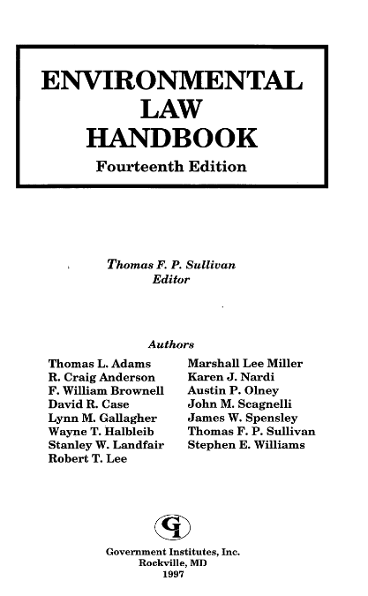
POSSIBILITIES:
/ $c Thomas F.P. Sullivan, editor.
/ $c Thomas F.P. Sullivan, editor ; authors, Thomas L. Adams, R. Craig Anderson, F. William Brownell, David R. Case, Lynn M. Gallagher, Wayne T. Halbleib, Stanley W. Landfair, Robert T. Lee, Marshall Lee Miller, Karen J. Nardi, Austin P. Olney, John M. Scagnelli, James W. Spensley, Thomas F.P. Sullivan, Stephen E. Williams.
/ $c Thomas F.P. Sullivan, editor ; authors, Thomas L. Adams [and fourteen others].
Notes:
How much of the statements of responsibility of these two books would you transcribe?
Human Rights: transcribe the authors’ titles and affiliations?
Environmental Law Handbook: record just the editor? Transcribe also all of the authors? Transcribe just the first author followed by “[and fourteen others]”?

Slide 9
Significant Differences - Descriptive
Abbreviations much less used - record what you see
Still used (see Appendix B):
for units of measurement and time (in. ft. hr. min. sec. fps ips rpm)
when found as an abbreviation on a resource
for part numbering in series access point (Bd. bk. n. no. n:o Nr. pt. T. v.)
Metric symbols are not abbreviations
245 10 Bangladesh Constitution : $b
trends and issues / $c Mustafa
Kamal.
260 Dhaka, Bangladesh : $b University
of Dhaka, $c 1994.
300 xvi, 177 p. ; $c 22 cm.
245 10 Bangladesh Constitution : $b
trends and issues / $c Justice
Mustafa Kamal.
264 _1 Dhaka, Bangladesh : $b University
of Dhaka, $c 1994.
300 xvi, 177 pages ; $c 22 cm
300 2 v. : $b ill., maps ; $c 25 cm.
300 2 volumes : $b illustrations, maps ;
$c 25 cm

Slide 10
AACR2:
260 Oxford ; $a Portland, Or. : $b
Hart Pub., $c 2009.
RDA:
264 _1 Oxford ; $a Portland, Oregon :
$b Hart Publishing, $c 2009.
or
264 _1 Oxford : $b Hart Publishing,
$c 2009.

Slide 11
AACR2:
250 14th ed.
RDA:
250 Fourteenth edition.

Slide 12
AACR2:
250 3rd ed.
RDA:
250 3rd edition.

Slide 13
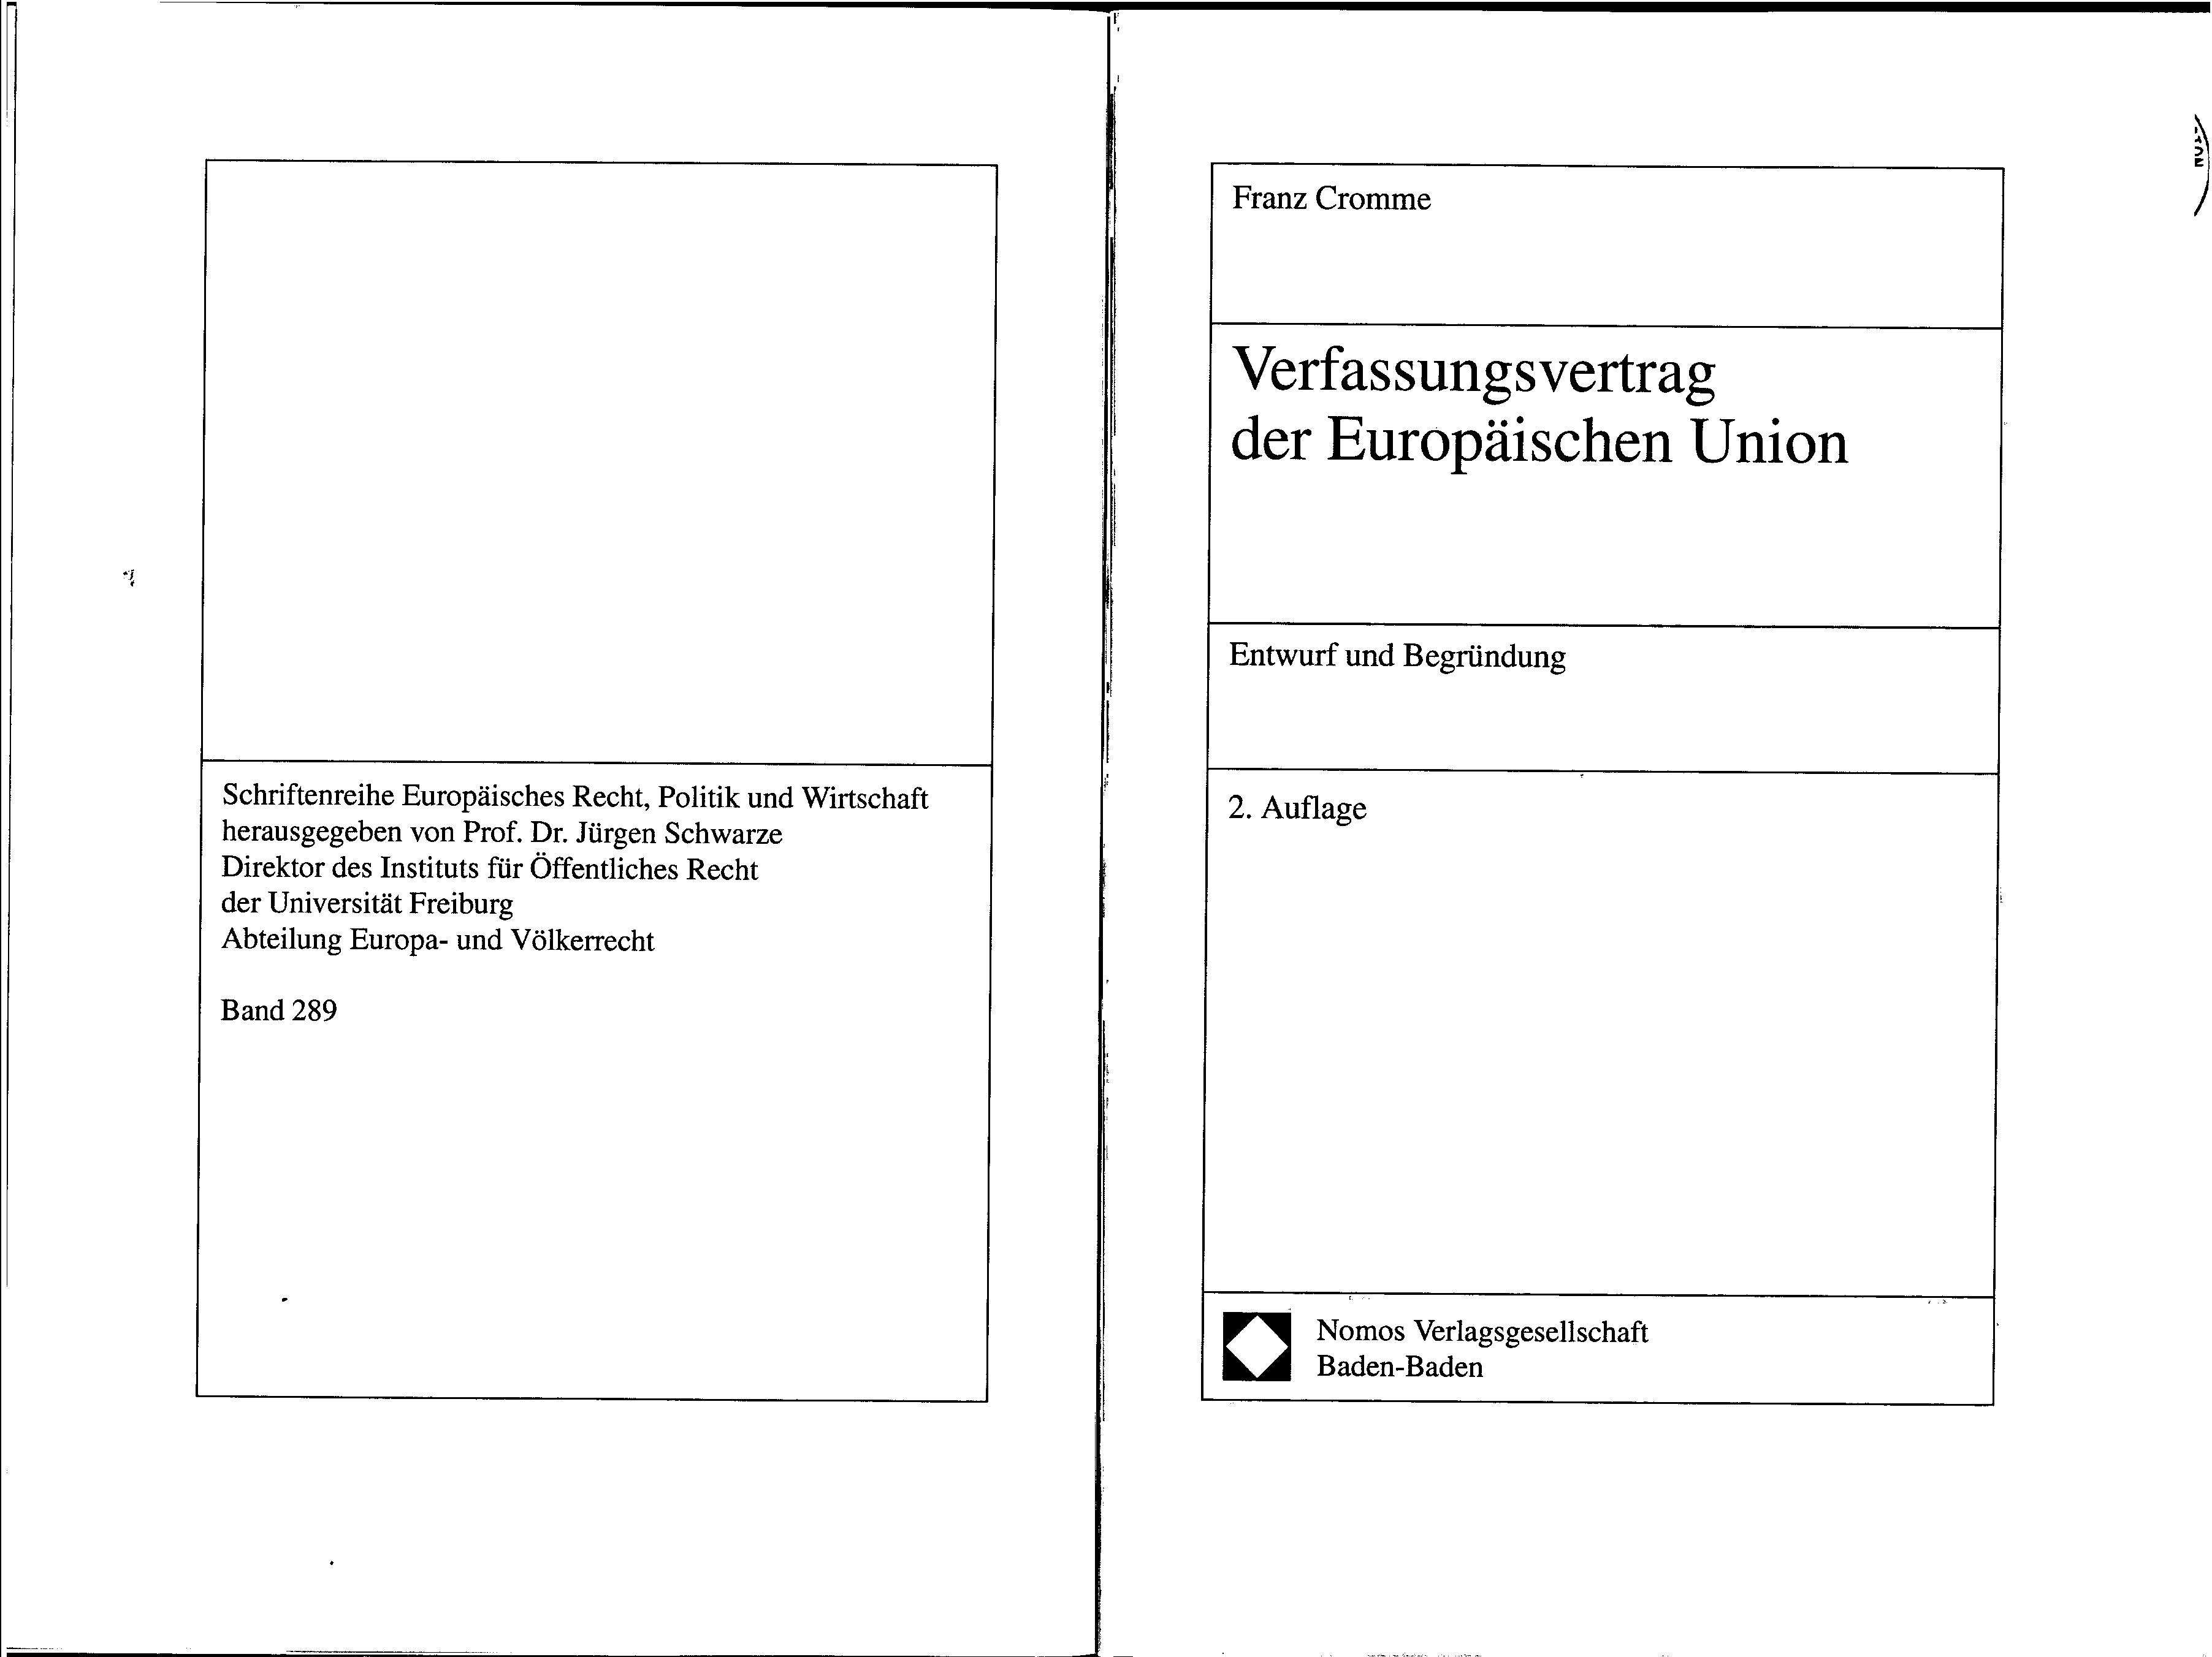
AACR2:
250 2. Aufl.
RDA:
250 2. Auflage.
AACR2:
490 1_ Schriftenreihe Europäisches Recht,
Politik und Wirtschaft ; $v Bd. 289
RDA:
490 1_ Schriftenreihe Europäisches Recht, Politik und Wirtschaft ; $v Band 289
Notes:
In the series statement, words associated with numbering are recorded as found in the resource. Numerals are recorded as found in the resource (1.8.2, first alternative - LC-PCC policy). However, numbers expressed as words are still recorded as numerals per 1.8.3.
1.8.3 Substitute numerals for numbers expressed as words.

Slide 14
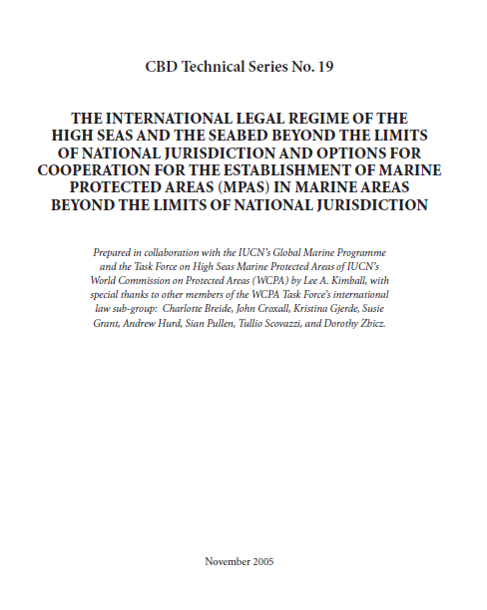
AACR2:
490 1_ CBD technical series ; $v
no. 19
RDA:
490 1_ CBD technical series ; $v
no. 19
No difference in this case! In series statements, transcribe abbreviations in numbering as found on the source of information used.

Slide 15
Significant Differences - Descriptive
Inaccuracies (typos) not corrected in the recorded element
Make note if necessary to explain
Record corrected title proper as a variant title if considered important for access
245 10 International terrorism and its
control : $b developing
international law and operational
machanisms [sic] / $c Satish Chandra.
245 10 International terrorism and its
control : $b developing
international law and operational
machanisms / $c Satish Chandra.
245 10 Sexual harrassment [sic] in the
workplace / $c by Latiff Sher
Mohamed.
246 3_ Sexual harrassment in the workplace
246 3_ Sexual harassment in the workplace
245 10 Sexual harrassment in the workplace
/ $c by Latiff Sher Mohamed.
246 1_ $i Title should read: $a Sexual
harassment in the workplace
Notes:
LCRI 21.30J. Titles of monographs corrected by "[i.e. …]" and "[sic]" or by bracketing missing letters (cf. 1.0F1). When the "[i.e. ...]," "[sic]" or bracketed letter(s) technique is used, make two title added entries: a 246-derived one for the title in its uncorrected form, and one in its correct form.
LC-PCC PS for 2.3.6.3
C. Corrected titles proper. In encountering titles proper that contain an incorrect form of some kind, insure that there is title access through both the incorrect and the corrected forms.
1. Titles of monographs. Make a variant title for the corrected form of the title proper.
245 02 $a A nev mechanism for transnational media complaints ...
246 1# $i Corrected title: $a New mechanism for transnational media complaints
245 04 $a The wolrd of television ...
246 1# $i Title should read: $a World of television
100 1# $a Patriot, John.
245 10 $a One day's dty ...
246 1# $i Correct title should read: $a One day's duty
2. Titles of serials and integrating resources (see RDA 2.3.1.4 exception). When the title proper has been transcribed in a corrected form, also make variant title for the title as it appears in the source. This treatment assumes that the title on later issues will be in the correct form on the pieces.
245 00 $a Housing starts ...
246 1# $i Title appears on volume 1, number 1 as: $a Housing sarts

Slide 16
Significant Differences - Descriptive
Inaccuracies (typos) not corrected in the recorded element
Make note if necessary to explain
Record corrected title proper as a variant title if considered important for access
245 10 Hearing on pending legislative [i.e.
legislation] : $b hearing before the
Committee on Veterans’ Affairs,
United States Senate, One Hundred
Tenth Congress, first session, October
24, 2007.
246 3_ Hearing on pending legislative
246 3_ Hearing on pending legislation
245 10 Hearing on pending legislative : $b
hearing before the Committee on
Veterans’ Affairs, United States
Senate, One Hundred Tenth
Congress, first session, October 24,
2007.
246 1_ $i Correct title should be: $a Hearing
on pending legislation

Slide 17
Significant Differences - Descriptive
Inaccuracies (typos) not corrected in the recorded element
Make note if necessary to explain
Record corrected title proper as a variant title if considered important for access
250 2nd ed.
Source of information has: Second Editoin
250 Second editoin.
Source of information has: Second Editoin
250 4th [i.e. 5th] ed.
Source of information incorrectly has: 4th Edition
250 4th edition.
500 Edition statement should read: 5th
edition.
490 1_ Kieler historische Studien ; $v Bd. 24
[i.e. 25]
490 1_ Kieler historische Studien ; $v Bd. 24
500 Series numbering should read: Bd. 25.

Slide 18
Significant Differences - Descriptive
Bracketing much reduced
Only when data recorded is taken from outside of the resource
For cataloger devised data (except devised titles, where a note is made instead)
250 3e [éd.].
250 3e [édition].
250 [Version] 1.1.
250 [Version] 1.1.
250 [New ed.]
250 [New edition].
260 Vancouver [Wash.] : $b City of
Vancouver, $c c2009.
264 _1 Vancouver : $b City of Vancouver, $c
[2009] or
264 _1 Vancouver [Washington] : $b City of
Vancouver, $c [2009]
Notes:
2.2.4 When instructions specify transcription, indicate that the information is supplied from a source outside the resource itself:
by means of a note (see 2.20) or by some other means (e.g., through coding or the use of square brackets).
Indicate that information is supplied for any of the following transcribed elements:
Edition statement
Designation of edition; Parallel designation of edition; Statement of responsibility relating to the edition; Parallel statement of responsibility relating to the edition; Designation of a named revision of an edition; Parallel designation of a named revision of an edition; Statement of responsibility relating to a named revision of an edition; Parallel statement of responsibility relating to a named revision of an edition
2.5.2.3 Record a designation of edition by applying the basic instructions at 2.5.1.
If a designation of edition consists of a letter or letters and/or a number or numbers (expressed either as numerals or as words) without accompanying words, add an appropriate word. Indicate that the information was taken from a source outside the resource itself (see 2.2.4).
2.8.2.3 Record the place of publication by applying the basic instructions at 2.8.1.
Include both the local place name (city, town, etc.) and the name of the larger jurisdiction or jurisdictions (state, province, etc., and/or country) if present on the source of information.
Optional Addition. Supply the name of the larger jurisdiction (state, province, etc., and/or country) as part of the local place name if considered important for identification or access. Indicate that the information was taken from a source outside the resource itself (see 2.2.4).

Slide 19
Title page
Title page verso
AACR2:
245 00 Verdict : $b Boris Berezovsky vs. Russia's
oligarchs / $c [compiled and edited by Yuri
Felshtinsky].
RDA:
245 00 Verdict : $b Boris Berezovsky vs. Russia's
oligarchs / $c compiled and edited by Yuri
Felshtinsky.

Slide 20
Significant Differences - Descriptive
Copyright date cannot substitute for date of publication
Copyright date only core if neither date of publication nor date of distribution is identified
Use  and  in RDA records instead of c and p
260 New York : $b Springer Pub. Co., $c
c2011.
264 _1 New York : $b Springer Publishing
Company, $c [2011]
or
264 _1 New York : $b Springer Publishing
Company, $c [2011]
264 _4 $c ©2011

Slide 21
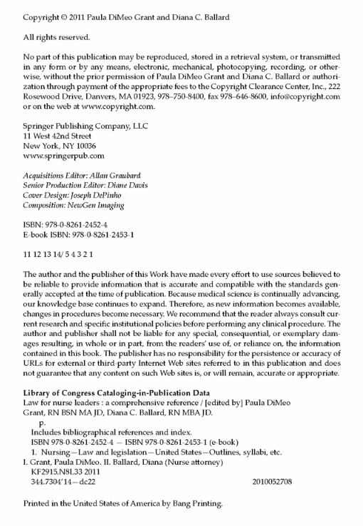
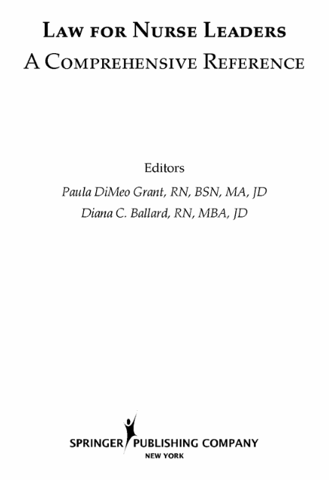

Slide 22
Significant Differences - Parallel Titles
Taken from anywhere in resource (2.3.3.2)
No limit on number transcribed (no first-level, second-level, or third-level of description as in AACR2; parallel titles proper are LC-PCC core)
Notes:
AACR2 1.1D4. Give parallel titles appearing outside the chief source of information in a note.
RDA 2.3.3.2 Take parallel titles proper from any source within the resource.
RDA 2.3.3.3 If there is more than one parallel title proper, record the titles in the order indicated by the sequence, layout, or typography of the titles on the source or sources of information.
LC-PCC PS for 2.3.3: Core Element for LC/PCC

Slide 23
COVER
TITLE PAGE
AACR2:
245 10 United Nations resolutions and decisions relating to the
Office of the United Nations High Commissioner for
Refugees.
246 1_ $i Parallel title on cover: $a Résolutions et décisions des
Nations Unies relatives au Haut Commissariat des Nations
Unies pour les réfugiés
RDA:
245 10 United Nations resolutions and decisions relating to the
Office of the United Nations High Commissioner for
Refugees = $b Résolutions et décisions des Nations Unies
relatives au Haut Commissariat des Nations Unies pour les
réfugiés.
246 31 Résolutions et décisions des Nations Unies relatives au
Haut Commissariat des Nations Unies pour les réfugiés

Slide 25
AACR2:
110 1 Vietnam.
245 10 Một số văn bản quy định khung pháp lý về bảo hộ giống cây trồng
Việt Nam.
246 15 Legal documents on Vietnamese plant variety protection
546 Vietnamese and English text on inverted pages.
RDA:
110 1 Vietnam.
245 10 Một số văn bản quy định khung pháp lý về bảo hộ giống cây trồng
Việt Nam = $b Legal documents on Vietnamese plant variety
protection.
246 31 Legal documents on Vietnamese plant variety protection
546 Vietnamese and English text on inverted pages.

Slide 26
AACR2:
245 13 al-Muḥāsabah wa-al-iblāgh al-mālī ʻan al-takālīf wa-al-
khuṣūm al-bīʼīyah / $c Muʼtamar al-Umam al-Muttaḥidah lil-
Tījārah wa-al-Tanmiyah = Huan jing cheng pen he fu zhai de kuai
ji he cai wu bao gao / Lian he guo mao yi he fa zhan hui yi =
Accounting and financial reporting for environmental costs and
liabilities / United Nations Conference on Trade and
Development.
246 31 Huan jing cheng pen he fu zhai de kuai ji he cai wu bao gao
246 31 Accounting and financial reporting for environmental costs
and liabilities
RDA:
245 13 al-Muḥāsabah wa-al-iblāgh al-mālī ʻan al-takālīf wa-al-khuṣūm
al-bīʼīyah / $c Muʼtamar al-Umam al-Muttaḥidah lil-Tījārah wa-al-
Tanmiyah = Huan jing cheng pen he fu zhai de kuai ji he cai wu
bao gao / Lian he guo mao yi he fa zhan hui yi = Accounting and
financial reporting for environmental costs and liabilities /
United Nations Conference on Trade and Development =
Comptabilité des coûts et passifs environnementaux et
présentation de l'information financière correspondante /
Conférence des Nations Unies sur le commerce et le
développement = Uchet i finansovaiaotchetnostʹ v oblasti
prirodookhrannykh raskhodov i ėkologicheskikh obiazatelʹstv /
Konferentsiia Organizatsii Obʺedinennykh Natsiĭ po
torgovle i razvitiiu = Contabilidad y presentación de informes
financieros sobre costos y responsabilidades ambientales /
Conferencia de las Naciones Unidas sobre Comercio y Desarrollo.
246 31 Huan jing cheng pen he fu zhai de kuai ji he cai wu bao gao
246 31 Accounting and financial reporting for environmental costs
and liabilities
246 31 Comptabilité des coûts et passifs environnementaux et
présentation de l'information financière correspondante
246 31 Uchet i finansovaiaotchetnostʹ v oblasti prirodookhrannykh
raskhodov i ėkologicheskikh obiazatelʹstv
246 31 Contabilidad y presentación de informes financieros sobre
costos y responsabilidades ambientales

Slide 27
Significant Differences - Access
Emphasis on the works and expressions that are in the manifestation being cataloged
Differentiate works whose authorized access point consists only of the preferred title and the titles are the same (including monographs!)
Emphasis on relationships
Don’t necessarily need to be justified in the description
Only the creator having principal responsibility or if principal responsibility is not indicated, only the first-named creator, is required
No more rule of three
No abbreviations in access points (b. d. ca. cent. fl. Jan.)
Profession/occupation available as a qualifier to personal names
July update will add new options for personal name qualifiers, including some that were available in AACR2 but not in the initial release of RDA
Conference names will include frequency

Slide 28
Works Named by Title Alone
Unlike AACR2, we will differentiate monographs with same titles when the authorized access point for the work is the preferred title alone. Consider these three works cataloged in AACR2:
245 00 American law : $b a finding list of books on this subject in public and private collections in Paris.
260 [Paris] : $b American Library in Paris, $c 1929.
245 00 American law : $b an introductory survey of some principles : cases and text / $c general editors, Samuel I. Shuman, Norbert D. West ; contributing editors, Kenneth R. Callahan ... [et al.].
260 Detroit : $b Wayne State University Press, $c 1971.
245 00 American law : $b the third century : the law Bicentennial volume / $c editor, Bernard Schwartz.
260 South Hackensack, N.J. : $b Published for New York University School of Law by F.B. Rothman, $c 1976.

Slide 29
Options for Breaking Conflicts - 6.27.1.9
Add Form of Work
Add Date of Work
Add Place of Origin of the Work
and/or
Add Other Distinguishing Characteristic of the Work
Notes:
6.27.1.9 Make additions to access points if needed to distinguish the access point for a work:
from one that is the same or similar but represents a different work
or
from one that represents a person, family, corporate body, or place.
Add one or more of the following elements, as appropriate:
a) the form of work (see 6.3)
b) the date of the work (see 6.4)
c) the place of origin of the work (see 6.5)
and/or
d) another distinguishing characteristic of the work (see 6.6).

Slide 30
What would you add as a qualifier to differentiate these works?
POSSIBILITIES: (Union catalog) (1929)
(Paris, France) (American Library in Paris)
130 0 American law ( )
245 10 American law : $b a finding list of books on this subject in public and private collections in Paris.
264 _1 [Paris] : $b American Library in Paris, $c 1929.
650 _0 Law $z United States $v Bibliography $v Union catalogs.
650 _0 Union catalogs $z France $z Paris.
130 0 American law ( )
245 10 American law : $b an introductory survey of some principles : cases and text / $c general editors, Samuel I. Shuman, Norbert D. West ; contributing editors, Kenneth R. Callahan, Donald H. Gordon, Maurice Kelman, Richard S. Miller, Peter E. Quint.
264 _1 Detroit : $b Wayne State University Press, $c 1971.
650 _0 Law $z United States $v Cases.
130 0 American law ( )
245 10 American law : $b the third century : the law Bicentennial volume / $c editor, Bernard Schwartz.
264 _1 South Hackensack, N.J. : $b Published for New York University School of Law by F.B. Rothman, $c 1976.
POSSIBILITIES: (Cases) (1971) (Detroit, Mich.)
(Wayne State University Press) (Shuman and West)
POSSIBILITIES: (Essays) (1976) (New York, N.Y.)
(New York University) (Schwartz) (Bicentennial volume)

Slide 31
Significant Differences - Access
Collaborative works: Rule of three
If more than one creator, name work by using entity with principal responsibility (some exceptions, e.g. motion pictures, musical works, treaties)
If multiple entities have principal responsibility, use the first-named one
If principal responsibility is not indicated, use the first-named of the creators
Compilations of works by different entities are still named by title alone
Notes:
6.27.1.2 Works Created by One Person, Family, or Corporate Body
6.27.1.3 Collaborative Works
6.27.1.4 Compilations of Works by Different Persons, Families, or Corporate Bodies
6.27.1.5 Adaptations and Revisions
6.27.1.6 Commentary, Annotations, Illustrative Content, Etc., Added to a Previously Existing Work

Slide 32
AACR2:
245 00 Human rights / $c by Louis
Henkin ... [et al.].
700 1 Henkin, Louis.
RDA:
100 1 Henkin, Louis, $e author.
245 10 Human rights / $c by Louis
Henkin, Gerald L. Neuman,
Diane F. Orentlicher, David W.
Leebron.
700 1 Neuman, Gerald L., $d 1952-
$e author.
700 1 Orentlicher, Diane, $e author.
700 1 Leebron, David W., $e author.
Notes:
Only the first named creator is core in RDA.
The PCC Guidelines for the Application of Relationship Designators in Bibliographic Records (http://www.loc.gov/aba/pcc/rda/PCC%20RDA%20guidelines/Relat-Desig-Guidelines.docx) state:
Include a relationship designator for all creators, whether they are coded MARC 1XX or MARC 7XX. If the MARC 1XX is not a creator, the addition of a relationship designator is optional though strongly encouraged. Add a relationship designator even if the MARC field definition already implies a relationship. Relationships should be coded explicitly and not inferred from MARC or other parts of the record.

Slide 33
PCC Policy for Addition of Relationship Designators
Include a relationship designator for all creators, whether they are coded MARC 1XX or MARC 7XX. If the MARC 1XX is not a creator, the addition of a relationship designator is optional though strongly encouraged. Add a relationship designator even if the MARC field definition already implies a relationship. Relationships should be coded explicitly and not inferred from MARC or other parts of the record.
Creators:
100 1 Agunias, Dovelyn Rannveig, $e author.
700 1 Newland, Kathleen, $e author.
Other entity associated with work (not a creator):
100 1 Hull, William, $d 1753-1825, $e defendant.
Guideline 9: PCC highly encourages including relationship designators (from Appendix I) for all access points whenever it is clear what the relationship is.
Guideline 13: The use of relationship designators for resource-to-resource relationships (from Appendix J) is encouraged.
Notes:
PCC Policy for Addition of Relationship Designators: http://www.loc.gov/aba/pcc/rda/PCC%20RDA%20guidelines/Relat-Desig-Guidelines.docx

Slide 34
Related Works - RDA 25.1
Related works can be recorded in three different ways (method of identifiers alone not used):
Authorized access point representing the related work
710 12 $i Contains (work): $a Argentina. $t Constitución (1949)
700 1 $i Guide to (work): $a Fischer, Louis, $d 1924- $t Teachers and the law.
711 2 $i Index to: $a Colloquium on the Law of Outer Space. $t Proceedings.
Structured description of the related work
505 0 Economic sanctions as a tool of foreign policy : short history of the U.S. experience / by Hrach Gregorian -- The end of economic sanctions? / by Richard J. Ellings -- Constitutional restraints on foreign economic sanctions / by Monroe Leigh and Jo Anne Swindler.
Unstructured description of the related work
500 Includes appendix: The draft Basic law of the Hong Kong Special Administrative Region of the People's Republic of China (for solicitation of opinions), pages 329-369.
525 Kept up-to-date between editions by supplements and advance code service pamphlets.
525 Edition for 1999 accompanied by an unnumbered volume with title: Alaska legal ethics opinions and rules governing the legal profession.
Notes:
LC-PCC PS for 25.1
Related work is a core element for LC for compilations: give a MARC 505 contents note unless the contents are indicated in another part of the description (e.g., in MARC 245 $a because no collective title is present). There is no limit on the number of works in the contents note unless burdensome. For compilations of works, give an analytical authorized access point for the predominant or first work in the compilation when it represents a substantial part of the resource. Disregard contributions such as a preface or introductory chapter. Generally, do not apply this core element to anthologies of poetry, hymnals, conference proceedings, journals, collections of interviews or letters, and similar resources.
Related work is also a core element for serial relationships such as “Continues,” “Continued by,” etc.; generally, give these as reciprocal relationships.
If RDA 6.27.1.6 is being applied to identify the work as a commentary, include in the bibliographic record an authorized access point for the original resource as a related work.

Slide 35
Notes:
505 for the contents?
700 author/title access points for the predominant or first-named work in the compilation?
700 author/title access points for all of the works?
Both 505 and 700s?
LC-PCC PS for 25.1
Related work is a core element for LC for compilations: give a MARC 505 contents note unless the contents are indicated in another part of the description (e.g., in MARC 245 $a because no collective title is present). There is no limit on the number of works in the contents note unless burdensome. For compilations of works, give an analytical authorized access point for the predominant or first work in the compilation when it represents a substantial part of the resource. Disregard contributions such as a preface or introductory chapter. Generally, do not apply this core element to anthologies of poetry, hymnals, conference proceedings, journals, collections of interviews or letters, and similar resources.
Related work is also a core element for serial relationships such as “Continues,” “Continued by,” etc.; generally, give these as reciprocal relationships.
If RDA 6.27.1.6 is being applied to identify the work as a commentary, include in the bibliographic record an authorized access point for the original resource as a related work.

